Slide 1
BALAARUN.R
821721104012
B.E-Computer Science and Engineering 3rd Year
Sir Issac Newton College of Engineering and Technology
3/21/2024 Annual Review

Slide 2
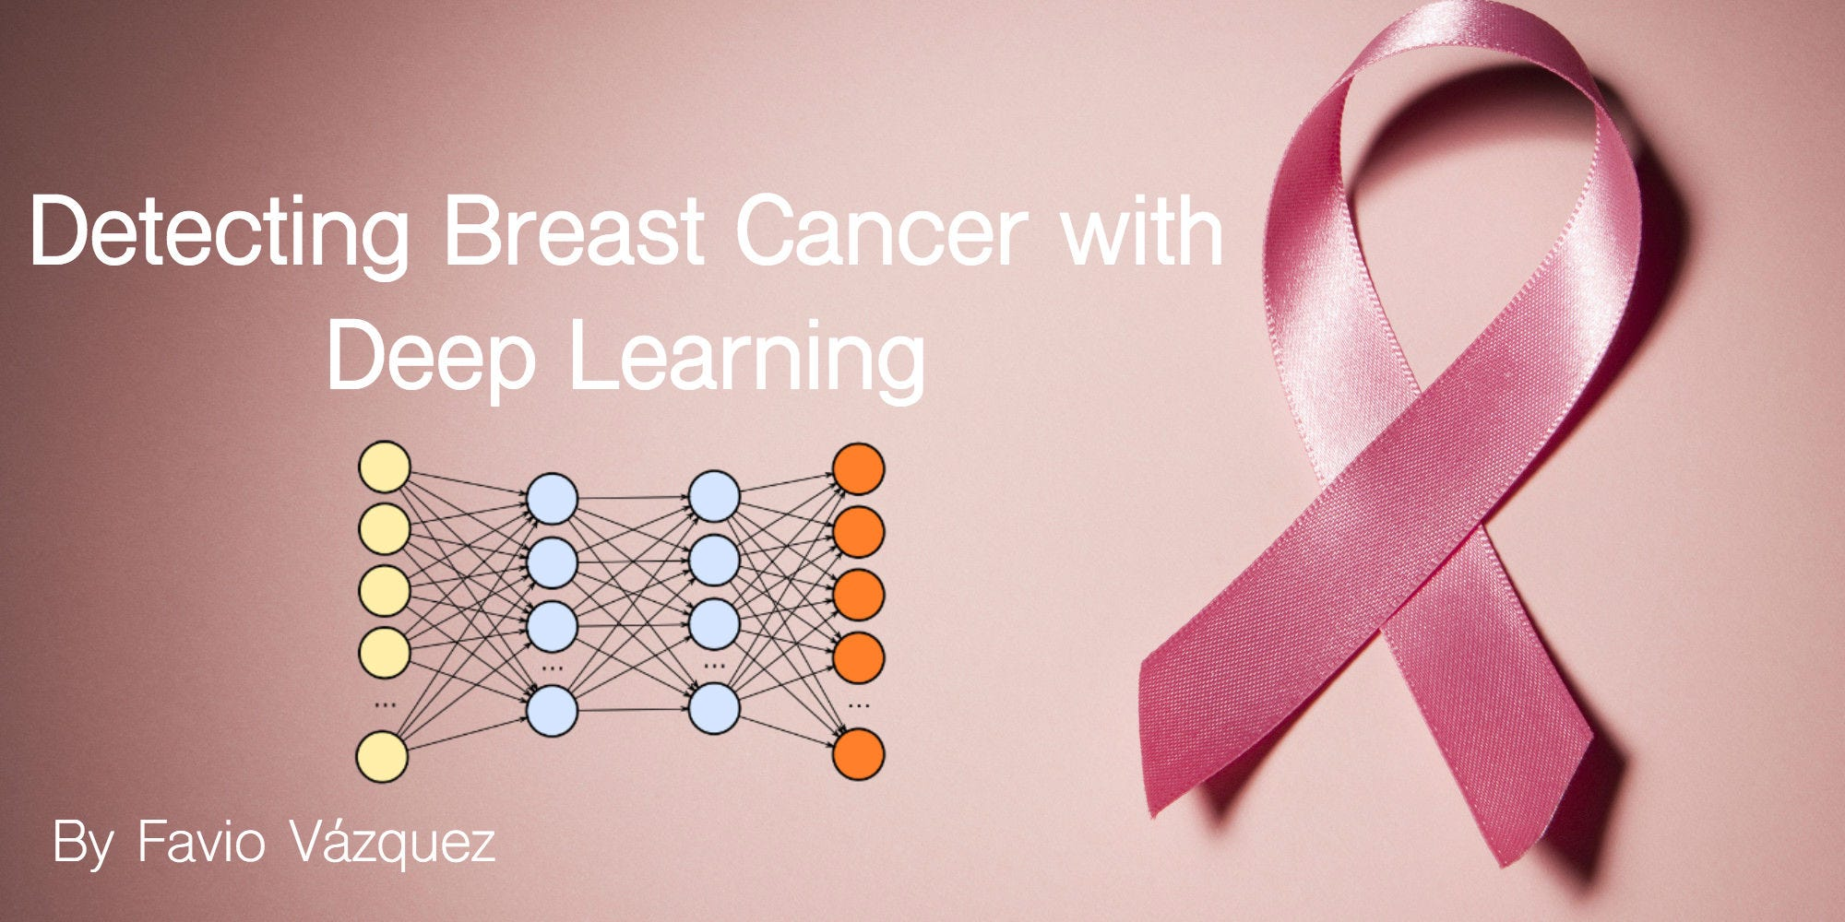
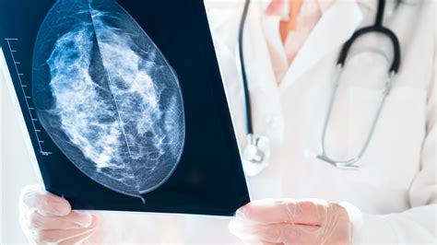
BREAST CANCER PREDICTION USING ARTIFICIAL NEURAL NETWORK(ANN)
3/21/2024 Annual Review

Slide 3


AGENDA
PROBLEM STATEMENT
PROJECT OVERVIEW
WHO ARE THE END USER?
YOUR SOLUTION AND ITS VALUE PROPESITION
THE WOW IN YOUR SOLUTION
MODELLING
RESULT
3/21/2024 Annual Review

Slide 4

PROBLEM STATEMENT
Breast cancer is one of the most prevalent forms of cancer among women worldwide, with early detection playing a crucial role in successful treatment and patient outcomes. However, accurate diagnosis relies heavily on the expertise of healthcare professionals and can be subject to variability.
The problem at hand is to develop a machine learning model that can accurately predict the likelihood of breast cancer based on patient data and tumor characteristics. This predictive model
Data Availability: Accessing comprehensive datasets containing patient demographics, medical history, and tumor characteristics such as size, shape, and histology.
Prediction Task: Framing the problem as a binary classification task to predict the likelihood of breast cancer (benign or malignant) based on available features.
Accuracy and Reliability: Developing a model that achieves high accuracy, sensitivity, and specificity to ensure reliable predictions and minimize false positives and false negatives.
Clinical Utility: Ensuring that the predictive model is interpretable and actionable for healthcare professionals, facilitating informed decision-making and treatment planning.
3/21/2024 Annual Review

Slide 5

PROJECT OVERVIEW
Introduction:
Overview of breast cancer as a prevalent health concern.
Importance of early detection in improving survival rates.
Objective of the project: Developing a machine learning model to predict breast cancer.
Data Collection and Preprocessing:
Collection of patient data including demographics and tumor characteristics.
Preprocessing steps: Handling missing values and standardizing features.
Exploratory Data Analysis (EDA):
Visualizing data distributions and correlations.
Understanding key features and their relationships with breast cancer diagnosis.
Feature Engineering and Selection:
Creating new features or transforming existing ones.
Selecting relevant features for model training.
Machine Learning Models:
Selection of classification algorithms: Logistic Regression, Decision Trees, etc.
Training and evaluation of models on the dataset.
Model Evaluation:
Assessing model performance using metrics like accuracy, precision, and recall.
Results and Insights:
Presentation of model performance and key findings.
Insights into significant features for breast cancer prediction.
3/21/2024 Annual Review

Slide 6

WHO ARE THE END USERS?
The end users for breast cancer prediction models primarily include healthcare professionals, patients, healthcare institutions, public health organizations, and researchers.
Healthcare professionals, including oncologists, radiologists, and primary care physicians, utilize these models to assist in early detection and diagnosis of breast cancer, aiding in treatment planning and patient care.
Patients benefit from these models by receiving timely and accurate diagnoses, leading to improved treatment outcomes and better quality of life.
Healthcare institutions implement breast cancer prediction models to enhance their screening and diagnostic processes, ultimately improving patient outcomes and satisfaction.
Public health organizations leverage these models to develop targeted breast cancer awareness campaigns, screening programs, and policies aimed at reducing the burden of the disease at a population level.
Researchers utilize breast cancer prediction models to advance scientific knowledge, develop new diagnostic tools, and explore innovative treatment strategies for breast cancer.
3/21/2024 Annual Review

Slide 7

YOUR SOLUTION AND ITS VALUE PROPOSITION
Machine learning models for breast cancer prediction offer a transformative approach to combating this prevalent disease. By leveraging advanced algorithms to analyze patient data and tumor characteristics, these models provide valuable insights that enhance early detection, treatment planning, and patient outcomes.
One of the key benefits of these models is their ability to detect breast cancer at an early stage, when treatment is most effective. By identifying subtle patterns and anomalies in medical imaging data, machine learning algorithms can alert healthcare professionals to potential cases of breast cancer, enabling timely intervention and improved survival rates for patients.
3/21/2024 Annual Review

Slide 8

THE WOW IN YOUR SOLUTION
The wow factor in utilizing machine learning for breast cancer prediction lies in its ability to revolutionize early detection and personalized treatment strategies. By analyzing vast amounts of patient data and tumor characteristics, machine learning models can identify subtle patterns indicative of breast cancer at its earliest stages. This enables healthcare providers to intervene proactively when treatment is most effective, ultimately improving patient outcomes and survival rates.
Moreover, machine learning algorithms can tailor treatment plans based on individual tumor characteristics and patient preferences, optimizing efficacy and minimizing side effects. This personalized approach empowers patients to take an active role in their healthcare decisions, leading to better treatment adherence and enhanced overall quality of life.
3/21/2024 Annual Review

Slide 9
MODELLING
Teams cam add wireframes
Homepage Wireframe:
Header: Navigation links for key sections like Prevention, Diagnosis, Treatment.
Hero Section: Image with brief message on breast cancer awareness.
Call-to-Action: Button to encourage action like scheduling a screening.
Information Sections: Summaries or links to key topics such as risk factors and screening guidelines.
Prevention and Risk Factors Wireframe:
Overview: Introduction to breast cancer prevention and risk factors.
Risk Factor Checklist: Interactive tool for users to assess their risk.
Prevention Strategies: Information on lifestyle changes and screening recommendations.
3/21/2024 Annual Review

Slide 10
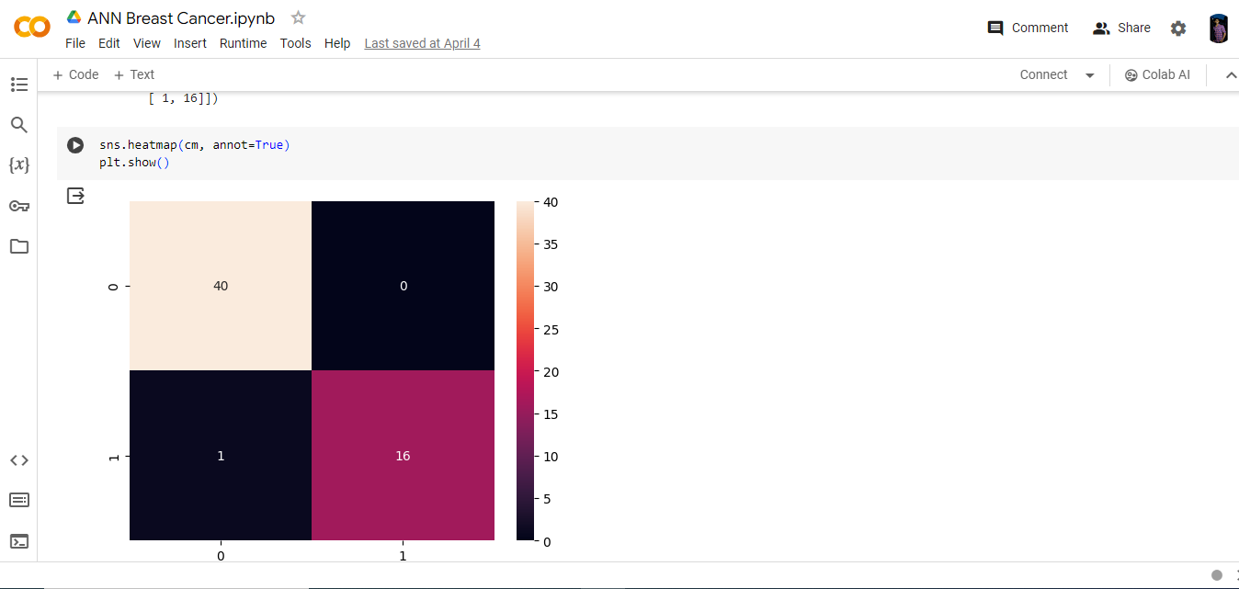
RESULTS
3/21/2024 Annual Review

